Slide 1
Getting Started & Lesson Plan
GitHub
https://github.com/NeotomaDB/Workshops/tree/ master/Montreal201904
Today: 3-5pm Introduction: Exploring, Visualizing, & Getting Data
Overview & Key Concepts
Neotoma Explorer: Searching, finding, exploring data
Tilia
APIs
R
Tomorrow: Data Steward Training
Tilia: Putting Data into Neotoma: Upload & Validation

Slide 2
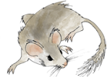
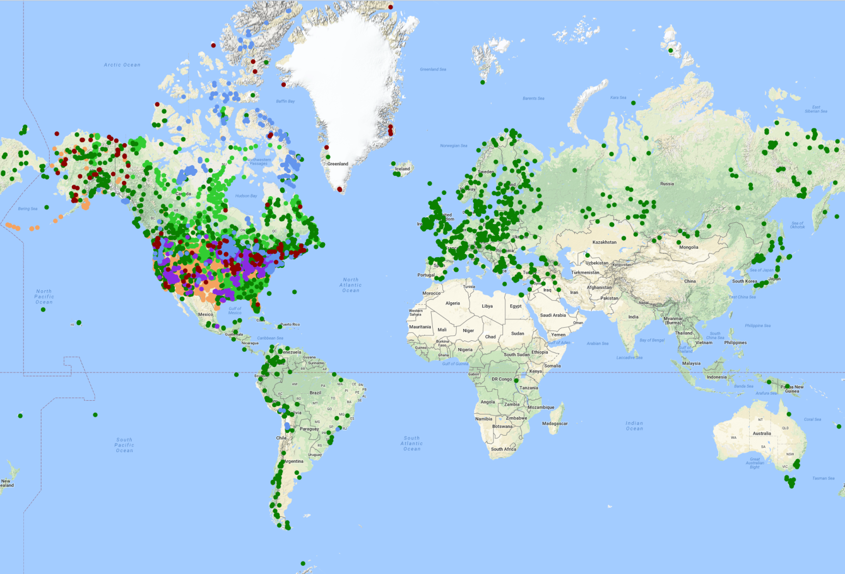
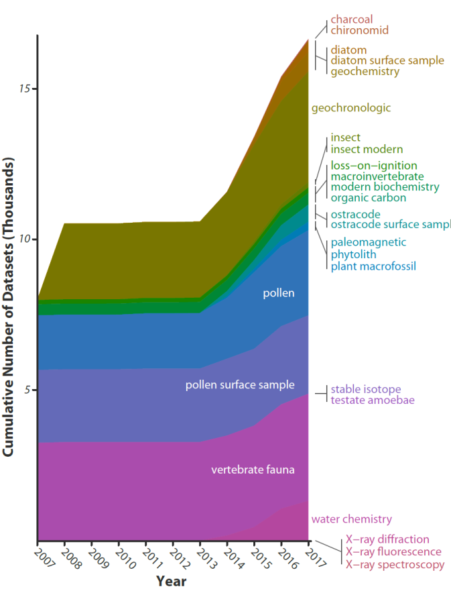
Neotoma Paleoecology Database
Neotoma DB
Mission: Support global-change research by providing an open, community-curated repository for multiple kinds of paleoecological data
>3.8 million observations
>17,000 datasets
>9,200 sites
Eric C. Grimm, Jack Williams, Jessica Blois, Allison Smith, Simon Goring, Joaquin Arroyo-Cabrales, Allan Ashworth, Julio Betancourt, Jessica Blois, Bob Booth, Phil Buckland, Don Charles, Steve Crawford, Brandon Curry, Ed Davis, Thomas Giesecke, Russ Graham, Steve Jackson, Claudio Latorre, Jonathan Nichols, Rob Roth, Mike Stryker, Hikaru Takahara, et al
www.neotomadb.org
Williams, Grimm et al. in rev. QR
Join as Member: https://tinyurl.com/NeotomaMember
Contribute Data: https://www.neotomadb.org/data/category/contribution

Slide 3
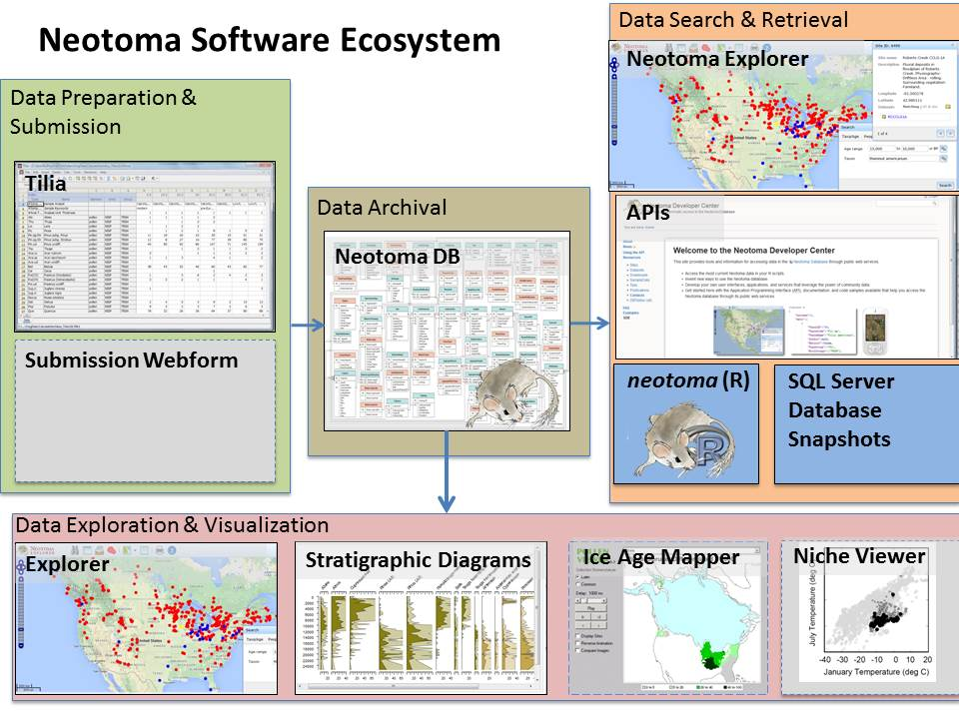
Neotoma Software Ecosystem

Slide 4
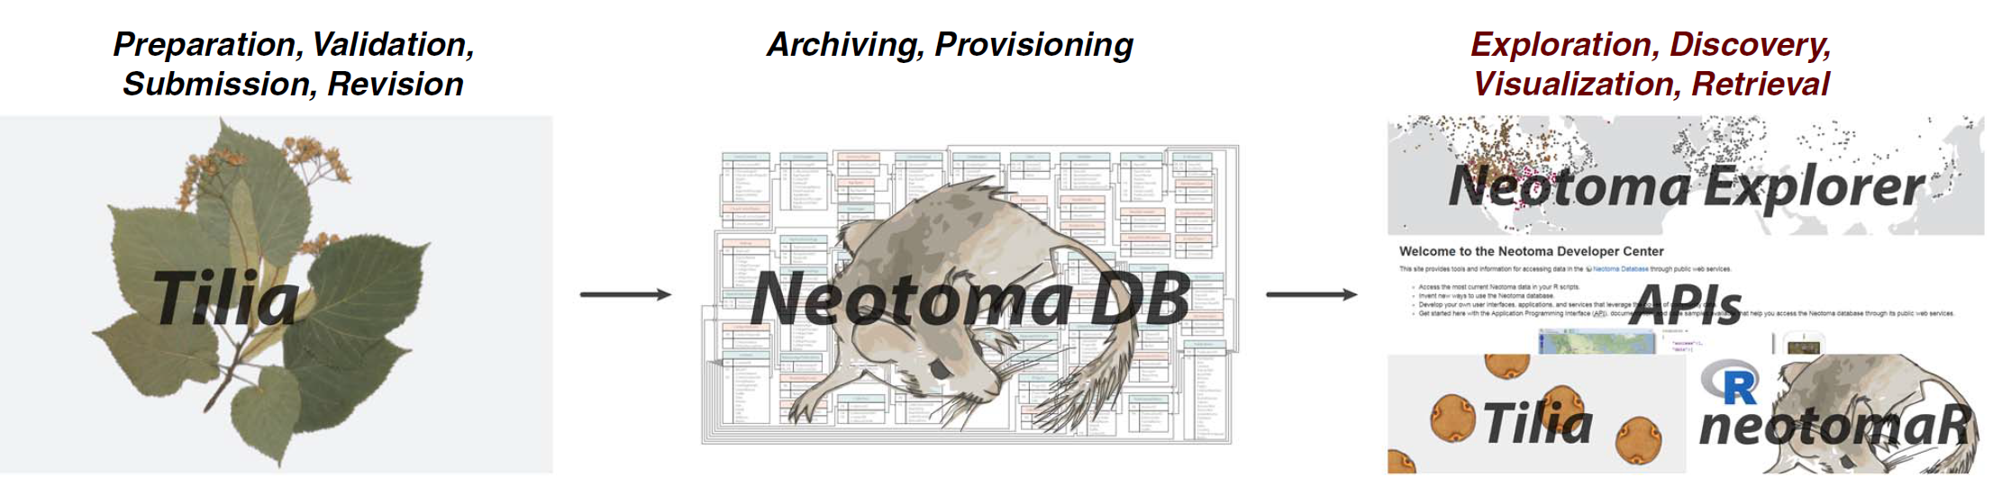
Neotoma Software Ecosystem
DOIs & Landing Pages

Slide 5
Neotoma Resources
Neotoma Explorer
http://apps.neotomadb.org/explorer/
Tilia
Download: http://www.tiliait.com/download/
Walk-Through Teaching Exercise, Neotoma Explorer
http://serc.carleton.edu/neotoma/activities.html
Neotoma Manual, Design Concepts, etc.
http://neotoma-manual.readthedocs.io/en/latest/index.html
Neotoma APIs
http://api.neotomadb.org/doc/
Neotoma R
Download: https://cran.r-project.org/package=neotoma
GitHub: https://github.com/ropensci/neotoma
Goring et al. 2015 Open Quaternary

Slide 6
Key Concepts: Sites, Collection Units, Analysis Units, Samples, Datasets
Sites
CollectionUnits
AnalysisUnits
Samples
Datasets
SiteID
SiteName
LongitudeEast
LatitudeNorth
LongitudeWest
LatitudeSouth
Altitude
Area
SiteDescription
Notes
CollectionUnitID
SiteID
CollTypeID
DepEnvtID
Handle
CollUnitName
CollDate
CollDevice
GPSLatitude
GPSLongitude
GPSError
WaterDepth
Location
Notes
AnalysisUnitID
CollectionUnitID
AnalysisUnitName
Depth
Thickness
FaciesID
Mixed
IGSN
Notes
SampleID
AnalysisUnitID
DatasetID
SampleName
AnalysisDate
LabNumber
PreparationMethod
Notes
DatasetID
CollectionUnitID
DatasetTypeID
DatasetName
Notes
One site may have many collection units
One collection unit may have many analysis units
One analysis unit may have many samples
A dataset comprises all samples of same type from same collection unit

Slide 7
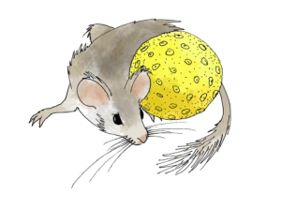
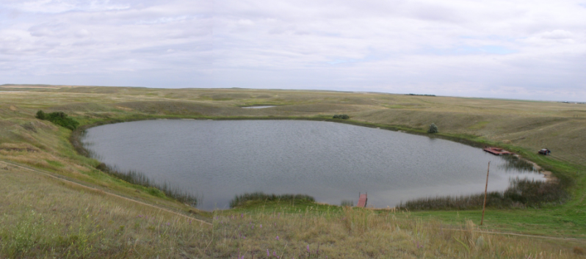
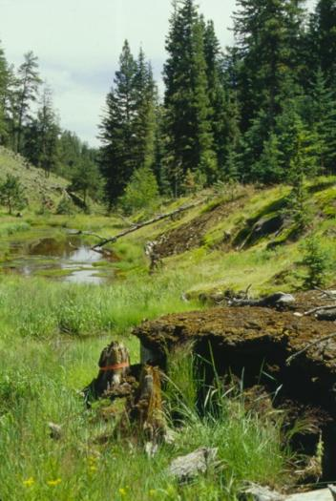
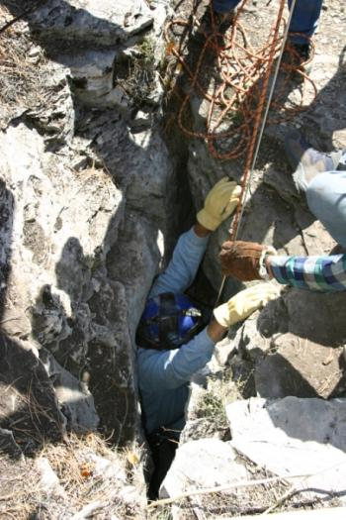
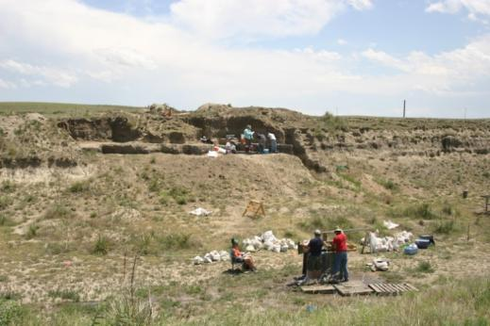
Sites
Sites Table
Lakes
SiteID
SiteName
LongitudeEast
LatitudeNorth
LongitudeWest
LatitudeSouth
Altitude
Area
SiteDescription
Notes
Sections
Caves
Archaeological Digs

Slide 8
Collection Units
Sites
CollectionUnits
Examples
Multiple cores w/in a lake
Multiple pits w/in an archaeological dig
Multiple bone piles within a cave
etc.
SiteID
SiteName
LongitudeEast
LatitudeNorth
LongitudeWest
LatitudeSouth
Altitude
Area
SiteDescription
Notes
CollectionUnitID
SiteID
CollTypeID
DepEnvtID
Handle
CollUnitName
CollDate
CollDevice
GPSLatitude
GPSLongitude
GPSError
WaterDepth
Location
Notes

Slide 9
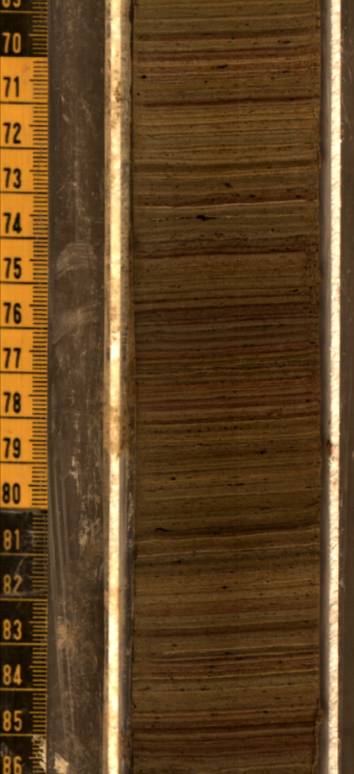
Analysis Units
CollectionUnits
AnalysisUnits
CollectionUnitID
SiteID
CollTypeID
DepEnvtID
Handle
CollUnitName
CollDate
CollDevice
GPSLatitude
GPSLongitude
GPSError
WaterDepth
Location
Notes
AnalysisUnitID
CollectionUnitID
AnalysisUnitName
Depth
Thickness
FaciesID
Mixed
IGSN
Notes
Analysis units have a depth and thickness
Example: depths within a sediment core

Slide 10
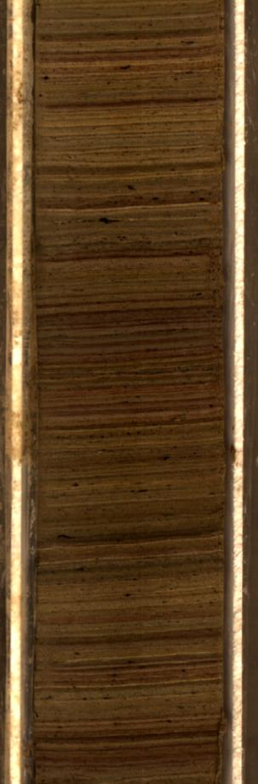
Samples
AnalysisUnits
Samples
AnalysisUnitID
CollectionUnitID
AnalysisUnitName
Depth
Thickness
FaciesID
Mixed
IGSN
Notes
SampleID
AnalysisUnitID
DatasetID
SampleName
AnalysisDate
LabNumber
PreparationMethod
Notes
Pollen
Charcoal
Diatoms
Loss-on-ignition
Example: pollen, charcoal, diatom samples from a single depth interval in a core

Slide 11
Time in Neotoma: Key Concepts
The Neotoma data model for time is based on three related concepts
Age Controls
Age-Depth Models
Chronologies
Age
Controls
Age-Depth Models
Chronologies

Slide 12
Geochronology
Geochronology
GeochronTypes
GeochronD
SampleID
GeochronTypeID
AgeTypeID
Age
ErrorOlder
ErrorYounger
Infinite
Delta13C
LabNumber
MaterialDated
Notes
GeochronTypeID
GeochronType
Amino acid racemization
Carbon-14
Cosmogenic
Electron spin resonance
Fission track
Potassium-argon
Optically stimulated luminescence
Lead-210
Silicon-32
Thermoluminescence
Uranium series
Carbon-14: accelerator mass spectrometry
Carbon-14: proportional gas counting
Carbon-14: liquid scintillation
Carbon-14: conventional radiometric
Argon-argon
Protactinium-231
Archaeomagnetic
Obsidian hydration
Paleomagnetic
Dendrochronological
In Neotoma, Geochronology stores the radiometric age controls

Slide 13
Chronologies
CollectionUnits
Chronologies
ChronControls
CollectionUnitID
SiteID
CollTypeID
DepEnvtID
Handle
CollUnitName
CollDate
CollDevice
GPSLatitude
GPSLongitude
GPSError
WaterDepth
Location
Notes
ChronologyID
CollectionUnitID
AgeTypeID
ContactID
IsDefault
ChronologyName
DatePrepared
AgeModel
AgeBoundYounger
AgeBoundOlder
Notes
ChronControlID
ChronologyID
ChronControlTypeID
Depth
Thickness
Age
AgeLimitYounger
AgeLimitOlder
Notes
In Neotoma, ChronControls stores the age controls used in an age model. Chronologies stores the age model metadata

Slide 14
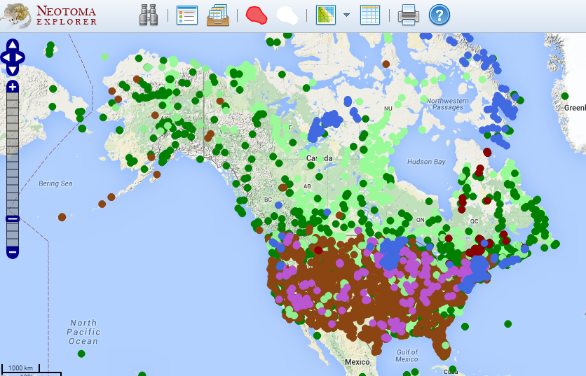
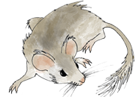
Neotoma Explorer (Finding/Exploring/Getting Data)
Neotoma DB
www.neotomadb.org
Walk-Through Teaching Exercise, Neotoma Explorer
http://serc.carleton.edu/neotoma/activities.html

Slide 16
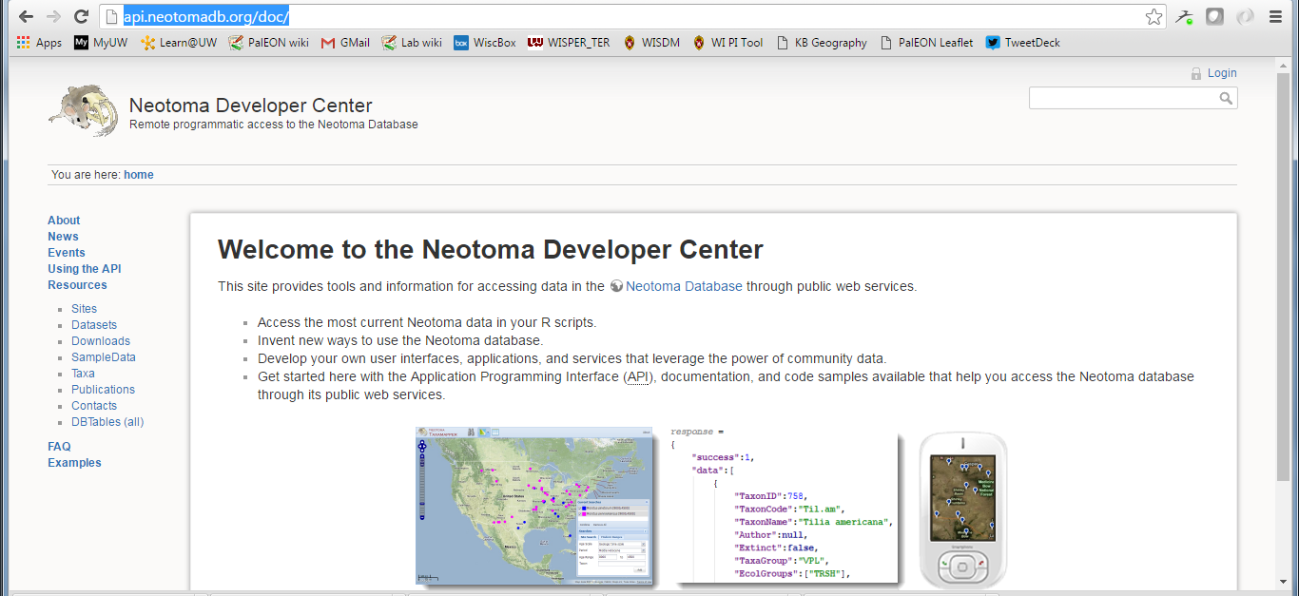
Neotoma APIs (Finding/Exploring/Getting Data)
Neotoma DB
www.neotomadb.org
APIs & Documentation available at:
http://api.neotomadb.org/doc/

Slide 17
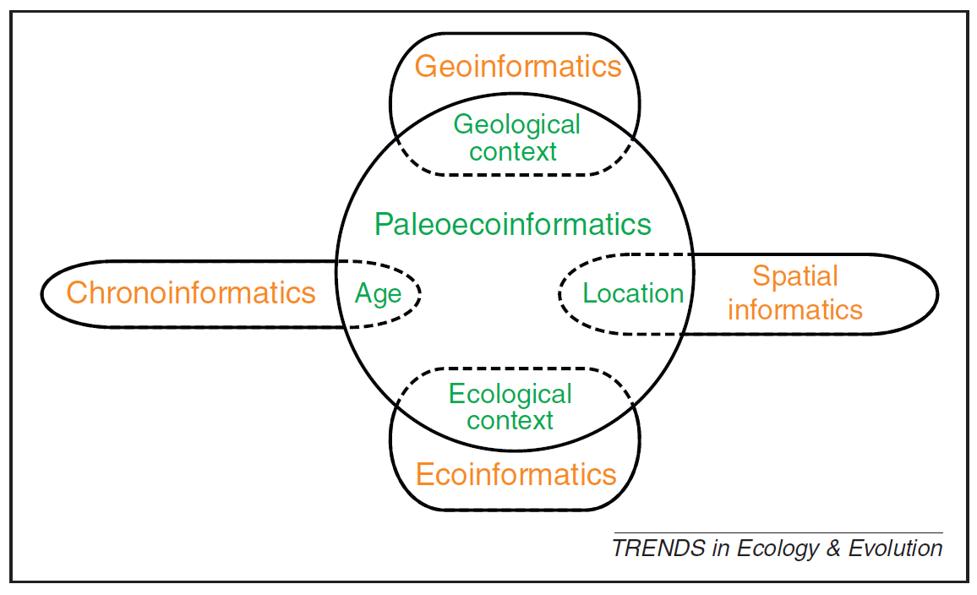
Informatics: designing systems that deliver the right information, to the right person in the right place and time, in the right way. (Wikipedia)
SCIENCE
INFORMATICS
Paleoecoinformatics: the collection, organization, analysis, synthesis, and curation of paleoecological data
Brewer et al. 2012 TREE

Slide 18
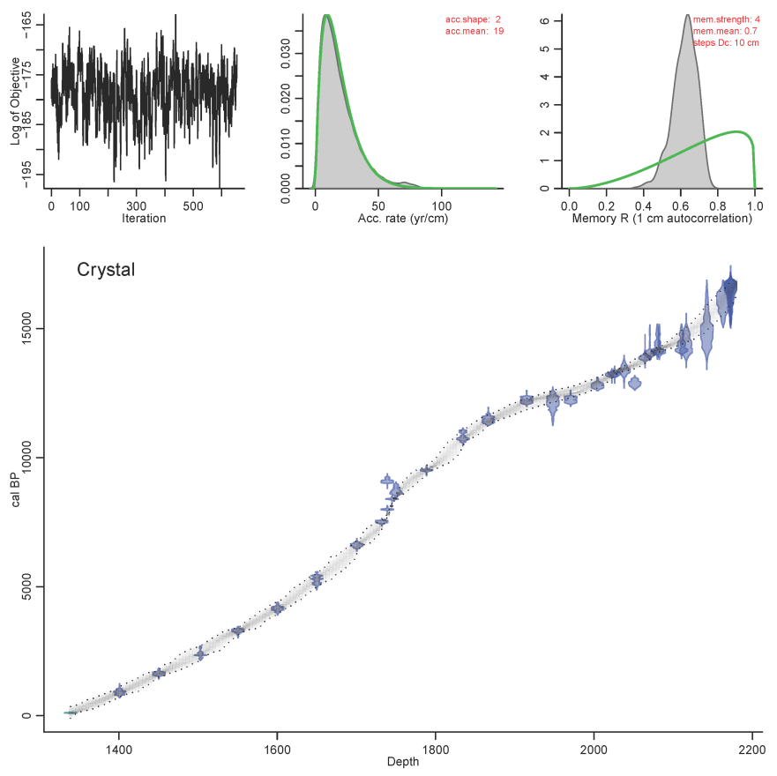
Age controls: an estimate of absolute age for a sample within a core or stratigraphic profile that is used to constrain an age model (e.g. radiocarbon dates)
Age-depth model: an algorithm used to estimate the age-depth relationship for a given stratigraphic profile.
Chronology: the series of estimated ages for a set of samples in a collection unit, linked to a particular combination of age controls and age-depth model

Slide 19
Neotoma Software Ecosystem

Slide 20
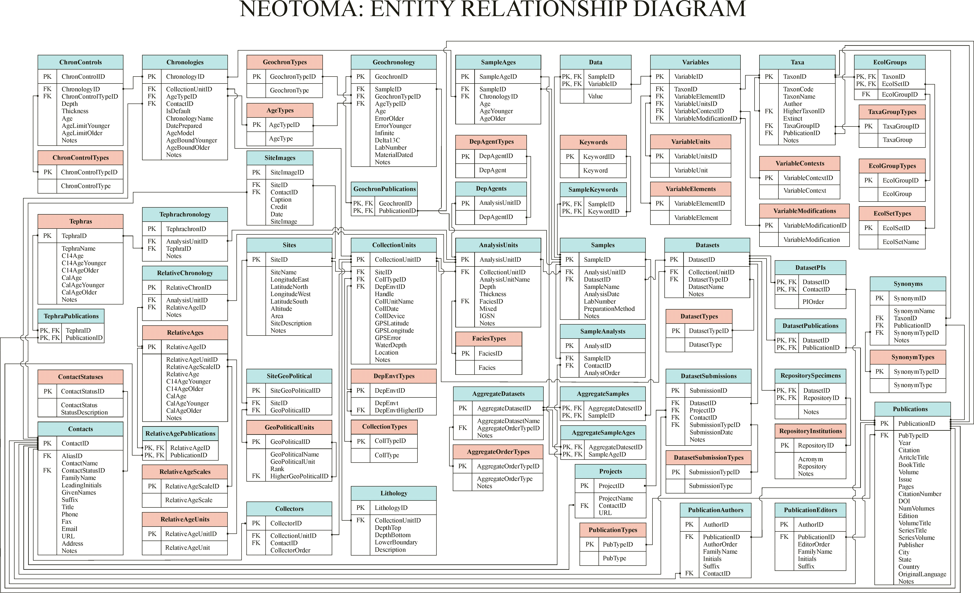
Neotoma Database
Database Structure

Slide 21
Tilia (Putting Data into Neotoma)
Neotoma DB
www.neotomadb.org
Free Download: http://www.tiliait.com/download/
Manual:

Slide 22
Neotoma Resources
Neotoma Manual, Design Concepts, etc.
http://neotoma-manual.readthedocs.io/en/latest/index.html
Neotoma APIs
http://api.neotomadb.org/doc/
Neotoma Explorer
http://apps.neotomadb.org/explorer/
Walk-Through Teaching Exercise, Neotoma Explorer
http://serc.carleton.edu/neotoma/activities.html
Tilia
Download: http://www.tiliait.com/download/
Neotoma R
Available at CRAN
Goring et al. 2015 Open Quaternary

Slide 23
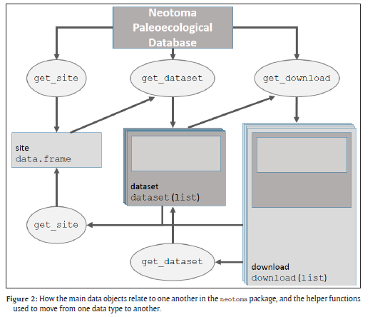
Neotoma R Porting Neotoma data to R environment
Key Functions
get_site
get_dataset
get_download
get_chroncontrol
get_table
get_taxa
Other Functions
get_closest
get_contact
get_publication
GitHub Repository: https://github.com/NeotomaDB/neotoma
Goring et al. 2015 Open Quaternary

